Slide 1
Sem Vi Project Learning Management system
Name: Kunal Saini
Class: TYBBA(CA) Div:’A’
Roll No: TA101

Slide 2
introduction
In college we submit assignments in form of written format and test conducted by teacher that are also in written format as a result of which there will be lots of wastage of pages. So, I decided to create such system which is easy to use, reliable, provide all the facilities like Create Assignment, Submit Assignments, Assessment, Create Course, Join Course. Discussion regarding any assignment, doubts, test etc.

Slide 3
objective
This system should provide facility to ask doubts from classmates and teacher at the same time.
This system should provide live lecture facility with recording feature.
This system should allow teachers to give notes as well as assignments to students.
This system should work for entire college/school, and not for small audience.
Should facilitate teachers to take and keep the record of previous attendance.

Slide 4
Scope of project
Discussion Forums are available for every course.
Teachers and Student can attend live lecture with the feature to record the lecture on single system.
This system allows Teachers to Assign assignments and Provide notes. In addition to this, Student can also submit his/her assignment which will be evaluated by the teacher later. Teacher and Students can do this by the feature to upload and download assignment.
Large number of audience (teachers and students) can make use of this system.

Slide 5
This system is easy to learn and handle for both Teacher and Student.
Teachers can take attendance by setting a specific time limit for students to attend lectures. Moreover, these records can be kept for later use.

Slide 6
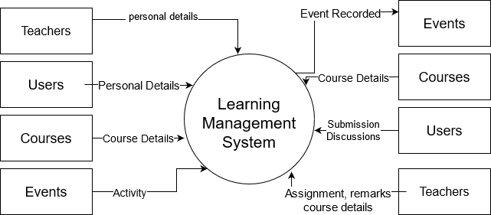
CONTEXT LEVEL DIAGRAM (CLD)

Slide 7
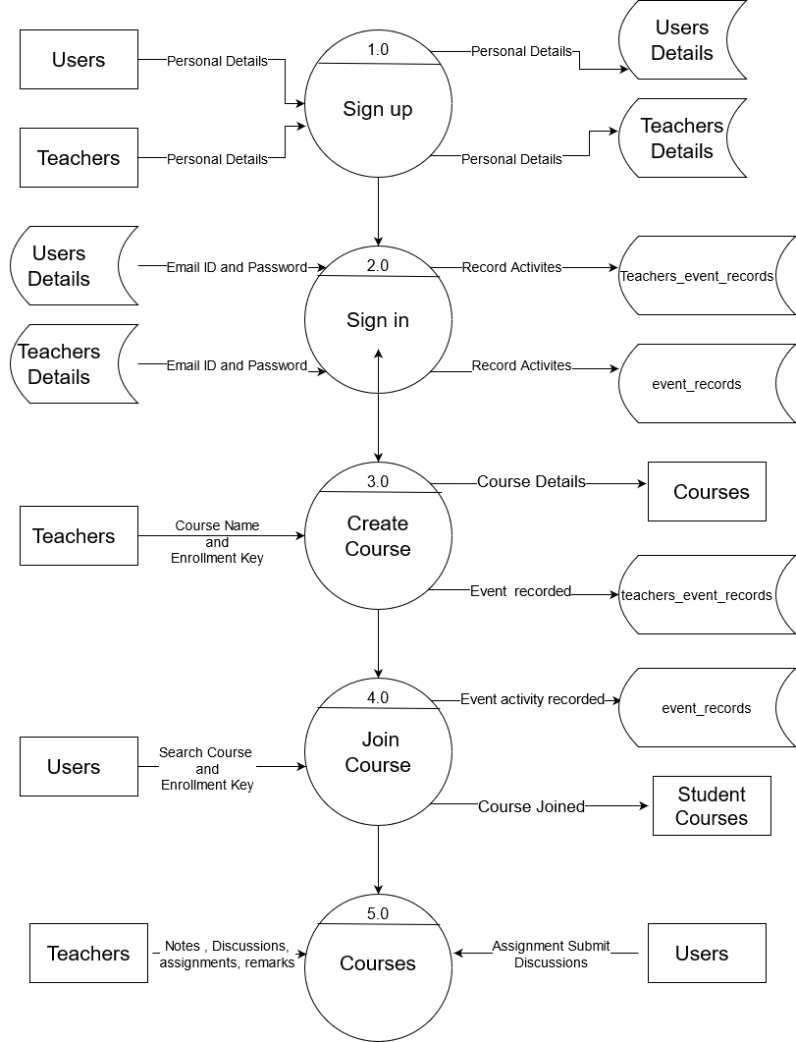
DATA FLOW DIAGRAM (DFD)

Slide 8
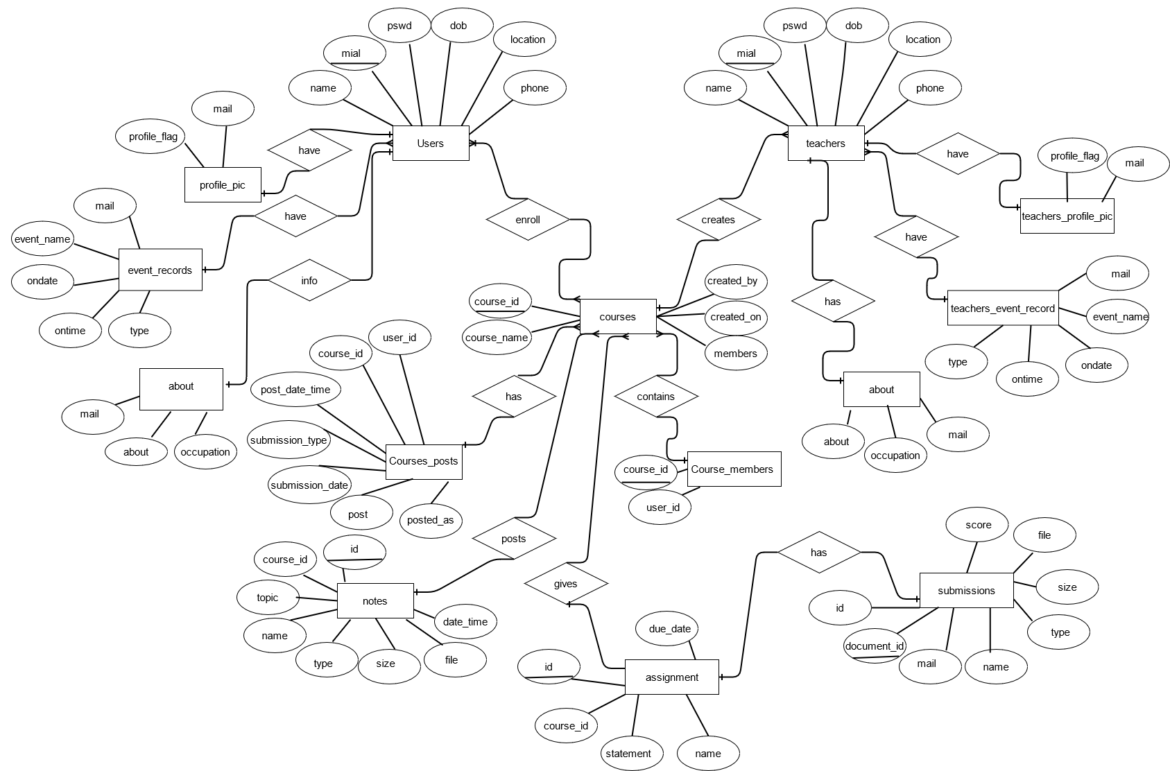
ENTITY-RELATIONSHIP DIAGRAM (ER DAIGRAM)

Slide 9
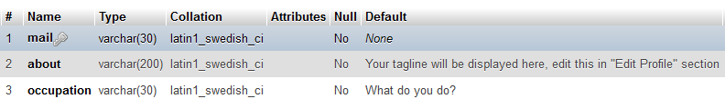
Data Dictionary
About

Slide 10
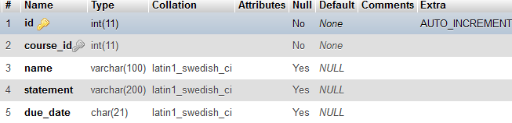
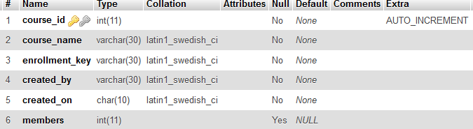
Assignment
Courses

Slide 11
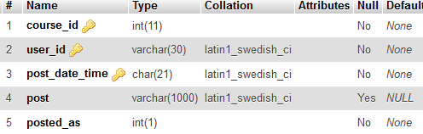
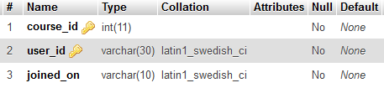
Course_posts
Course_students

Slide 12
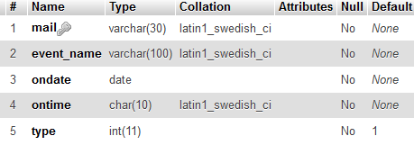
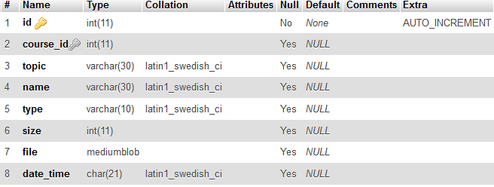
Event_records
Notes

Slide 13

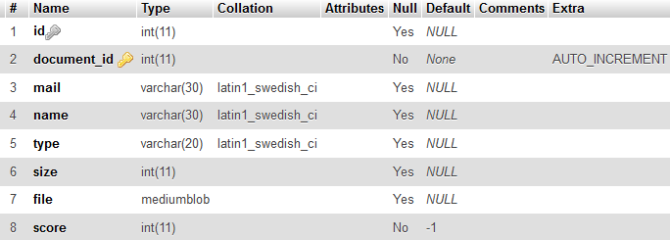
Profile_pic
Submissions

Slide 14
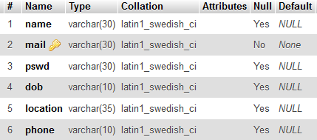
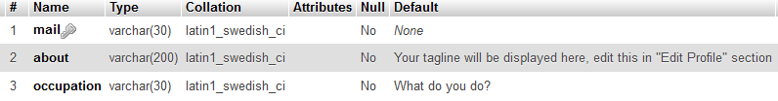
Teachers
teachers_about

Slide 15
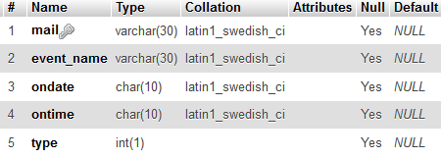

Teachers_event_records
Teachers_profile_pic

Slide 16
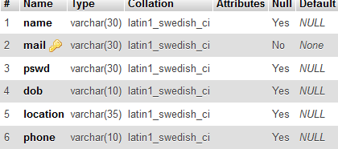
users

Slide 17
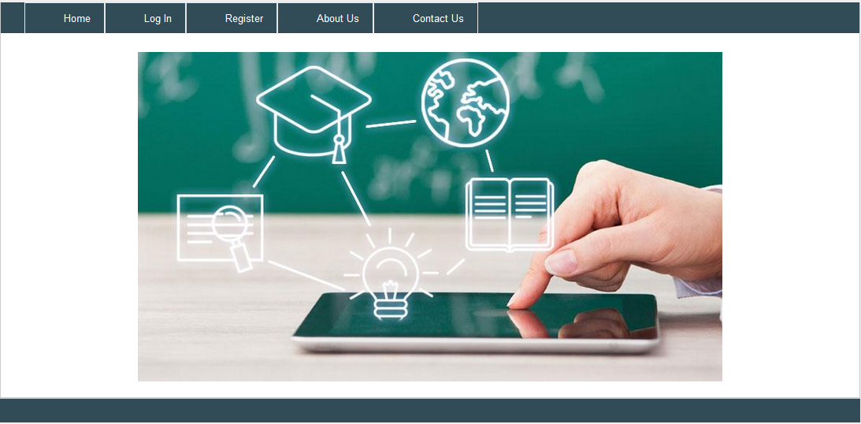
Form Designs
Home Page

Slide 18
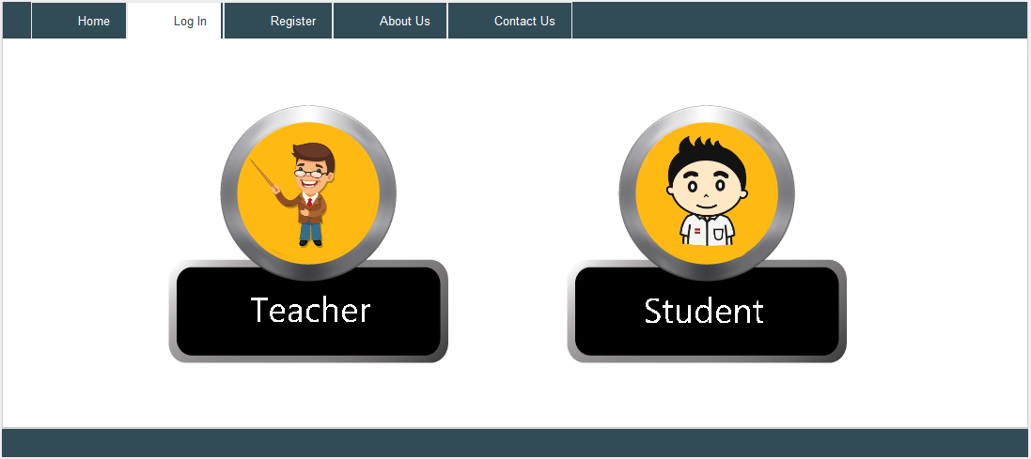
Login Page

Slide 19
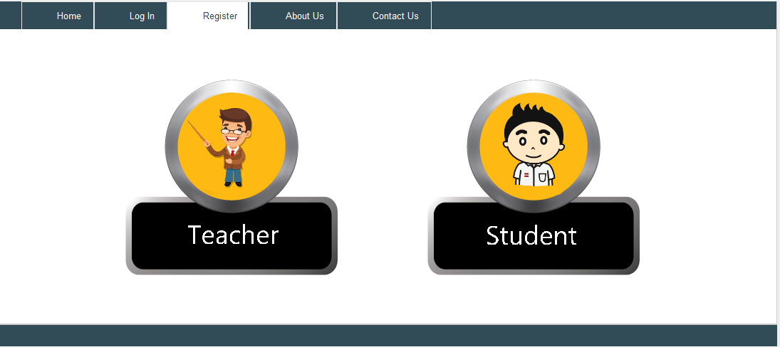
register Page

Slide 20
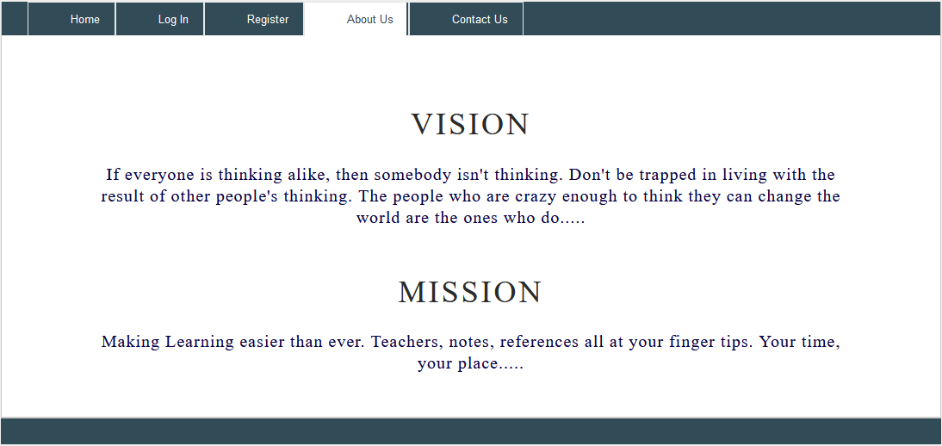
About Page

Slide 21
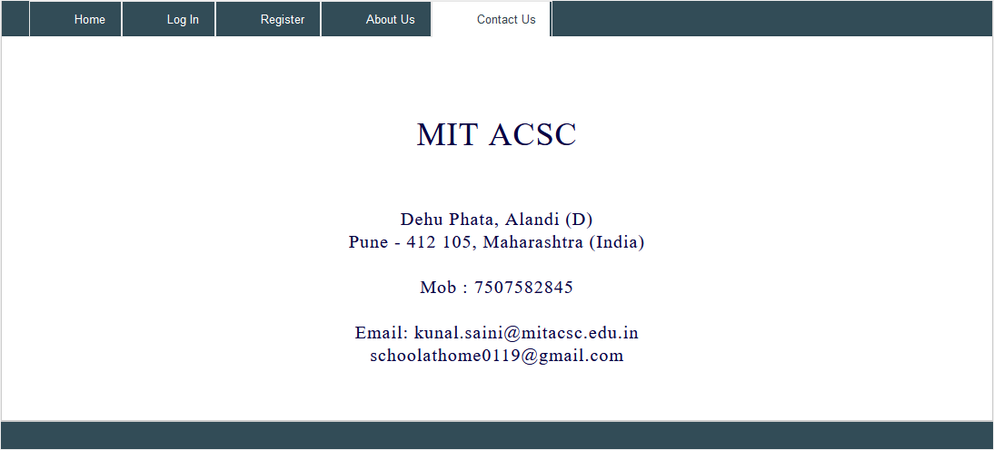
Contact Us Page

Slide 22
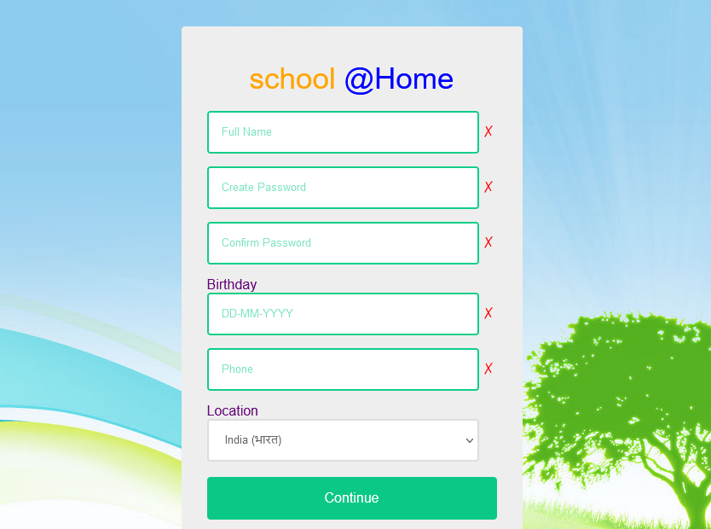
Registration

Slide 23
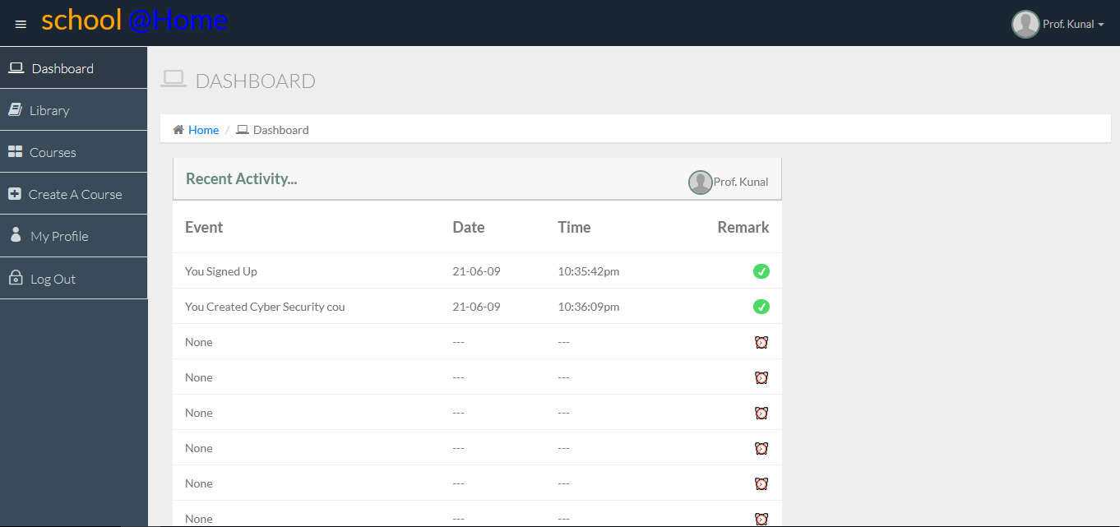
Dashboard

Slide 24
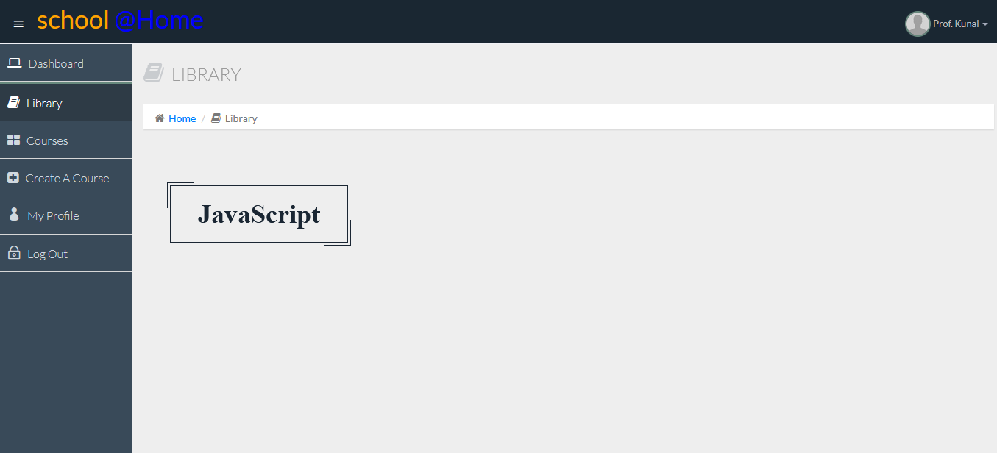
Library

Slide 25
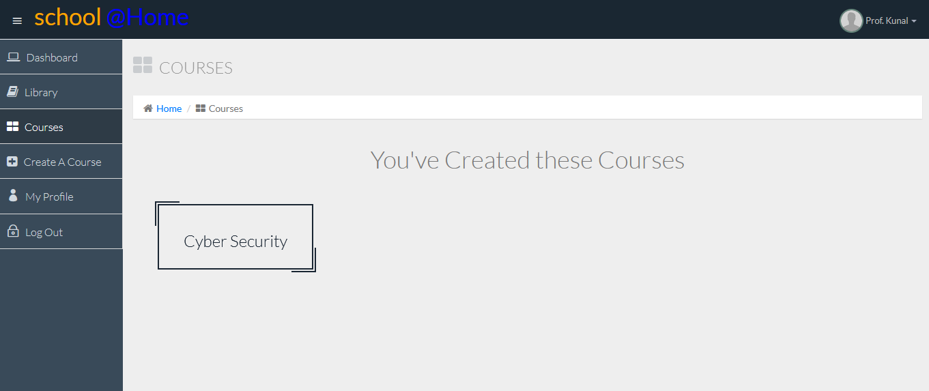
Courses

Slide 26
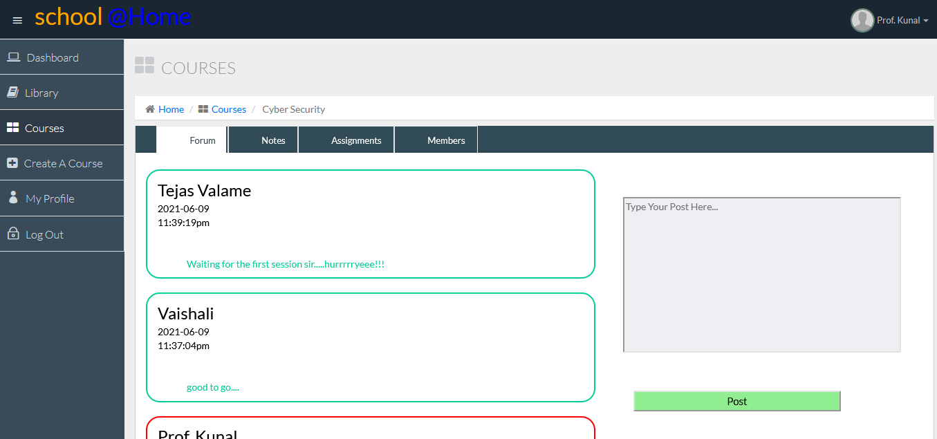
Forum

Slide 27
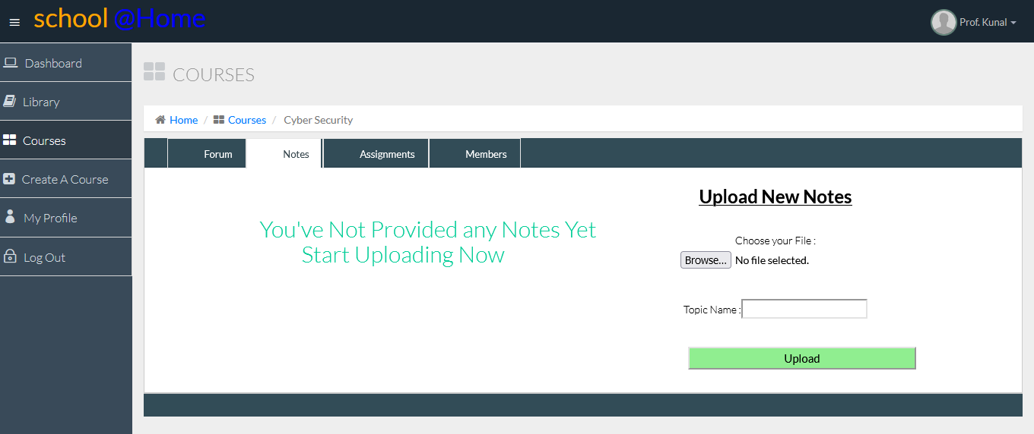
Notes

Slide 28
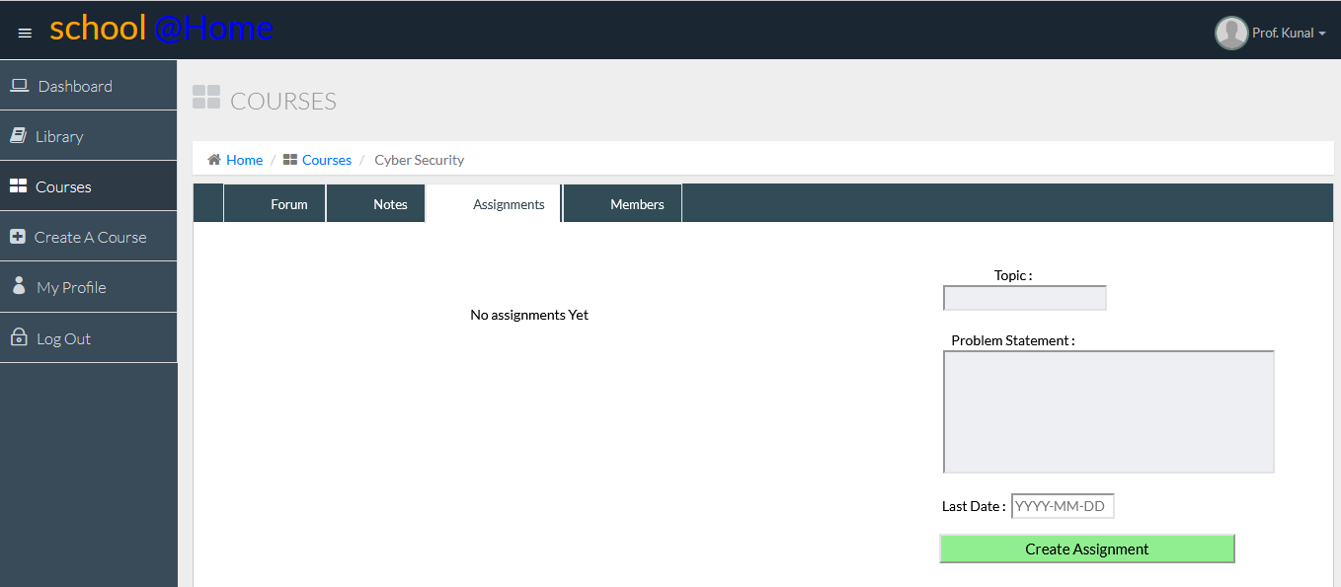
Assignment

Slide 29
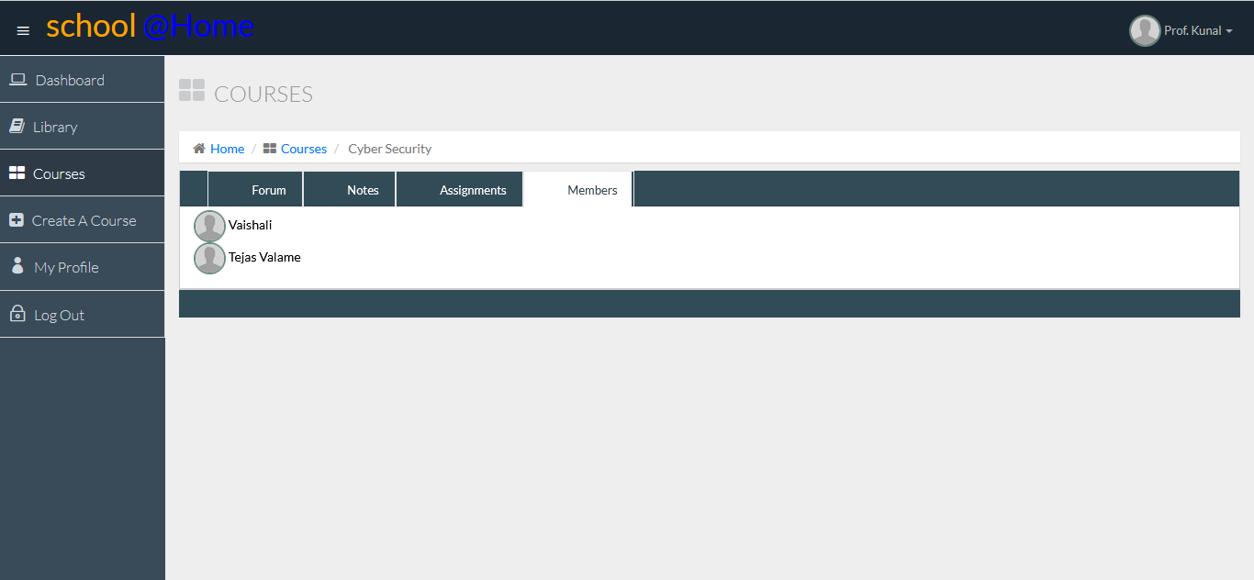
Members

Slide 30
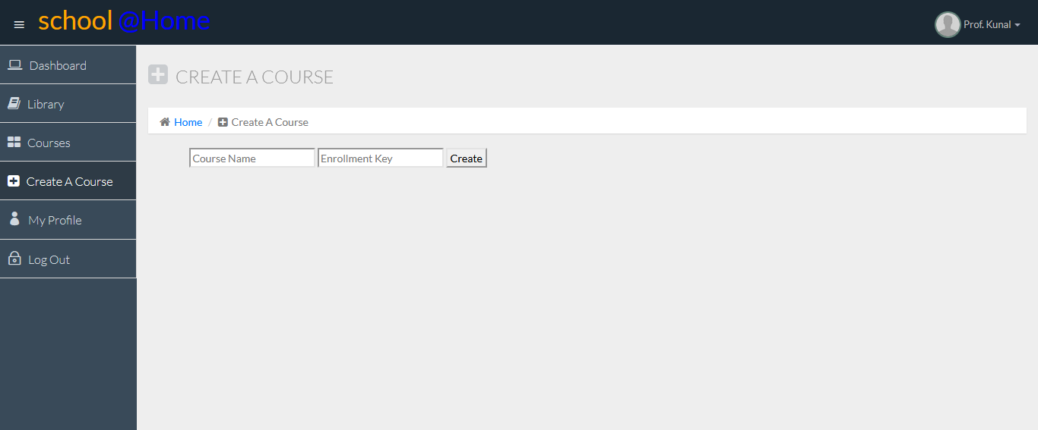
Create A Course

Slide 31
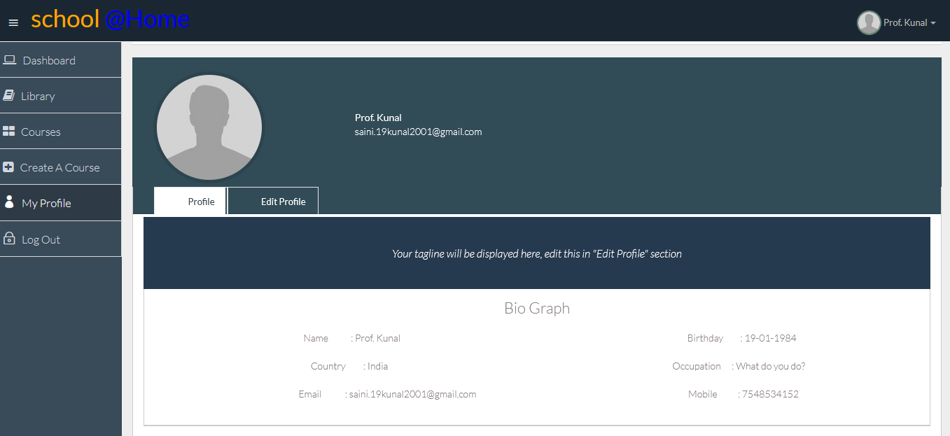
Profile

Slide 32
Advantages of Learning Management System
Discussion Forums are available for every course.
Teachers and Student can attend live lecture with the feature to record the lecture on single system.
This system allows Teachers to Assign assignments and Provide notes. In addition to this, Student can also submit his/her assignment which will be evaluated by the teacher later. Teacher and Students can do this by the feature to upload and download assignment.
Large number of audience (teachers and students) can make use of this system.
This system is easy to learn and handle for both Teacher and Student.
Teachers can take attendance by setting a specific time limit for students to attend lectures. Moreover, these records can be kept for later use.

Slide 33
Future Enhancement
report card generation.
ability for the teacher to add student in the course.
ability for teacher to delete a course.
ability for teacher to remove a student from a course.
ability to do online class (video conferencing, recording, automatic attendance).

Slide 34
Biblography
Video lecture for beginners by the new Boston on the topic Introduction to PHP.
Link - https://www.youtube.com/watch?v=iCUV3iv9xOs&list=PL442FA2C127377F07
YouTube video on the topic Introduction to PHP programming by mmtuts
https://www.youtube.com/watch?v=qVU3V0A05k8&list=PL0eyrZgxdwhwBToawjm9faF1ixePexft-

Slide 35
www.learningaboutelectronics.com
How to insert files into MySQL database using php:
http://www.learningaboutelectronics.com/Articles/How-to-insert-files-into-a-MySQL-database-using-PHP.php
www.w3schools.com
Profile picture upload in database:
https://www.w3schools.com/php/php_file_upload.asp

Slide 36
https://getmdl.io/components/index.html#menus-section : For Templates, Styles and Components
https://netcorecloud.com/tutorials/send-an-email-via-gmail-smtp-server-using-php/ : Sending an email to using php to gmail.
GitHub (https://github.com/PHPMailer/PHPMailer/ ) : for PHP Mailer
https://www.codexworld.com/upload-store-image-file-in-database-using-php-mysql/ : How to upload files.
https://stackoverflow.com/questions/32329586/how-do-i-download-a-file-using-php-and-mysql-db : To download a file using PHP and MySQL

Slide 37
Thank you :)

